Slide 1
Litterature overview
Papers that describe CNN decomposition
While learning - tensorized training
After learning - tensorized inference

Slide 2

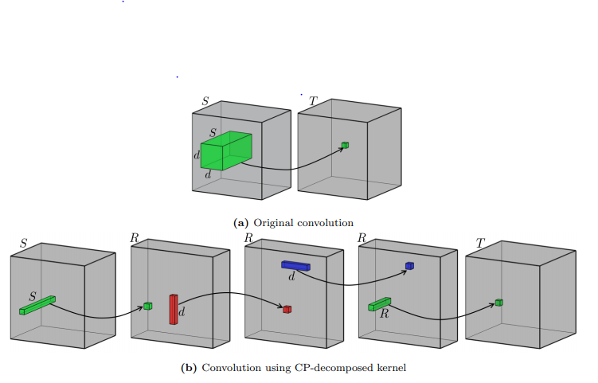
Learning while decomposed vs decomposing something learnt

Slide 3

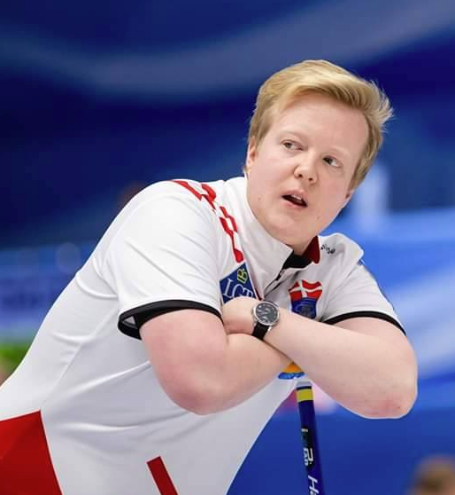
Evaluation of synergistic effects of tensor decomposition methods within (deep) neural network applications Tobias
Comprehensive collection of knowledge about the subject
Uses tensor calculus - CP and Tucker
Decomposes after training – Tensorized Inference

Slide 4
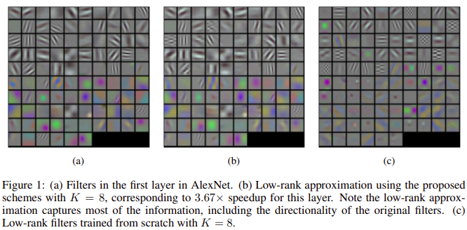
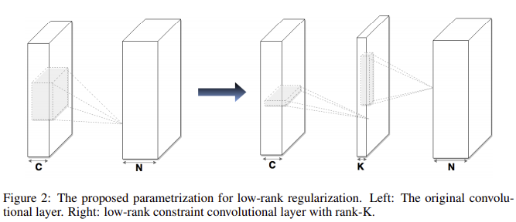
CONVOLUTIONAL NEURAL NETWORKS WITH LOWRANK REGULARIZATION Cheng Tai1 , Tong Xiao2 , Yi Zhang3 , Xiaogang Wang2 , Weinan E1
Trains large CNN's
Finds global optimizer of decomposition – each layer becomes 2 smaller layers
New algorithm for training low-rank constrained CNN

Slide 5
SPEEDING-UP CONVOLUTIONAL NEURAL NETWORKS USING FINE-TUNED CP-DECOMPOSITION Vadim Lebedev1,2, Yaroslav Ganin1 , Maksim Rakhuba1,3, Ivan Oseledets1,4, and Victor Lempitsky1
Uses CPD to convert the 4D kernel of each layer into rank one tensors.
Uses these to create 4 layers with small kernels.
Then is (somehow) still able to fine tune with back prop
Why not initialize and decompose that, and then (fine) tune? (is the fine tuning slow/bad but the flops when using the fine tuned network small?)

Slide 6
Video Scene Segmentation Using Tensor-Train Faster-RCNN for Multimedia IoT Systems Cheng Dai, Xingang Liu, Laurence T. Yang, Minghao Ni, Zhenchao Ma, Qingchen Zhang and M. Jamal Deen
Uses region convolution neural networks
Detects segments
"decomposition to factor the input-to-hidden weight matrix, is proposed"
Maybe not a first source but a link
In short, tensor based methods for deep learning network compression can be classified into two categories namely tensorized inference and tensorized training [23]. For tensorized inference, it uses the idea train and then compress. The neural network is first trained with higher computation machine such as GPU cluster, and then tensor decomposition is employed to compress the well-trained model into a smaller one to make it available to be deployed on a device with limited resource. For a simple example, Denton et al. proposed a method which compresses the weight matrix by using low-rank CP decomposition [24]. However, for tensorized training, the convolution kernel can be deemed as a 4D tensor, laying the theoretical foundation for tensor-train mechanism. Then a higher-order tensor can be represented as a set of smaller core-tensors with fewer parameters and thus realize the model size compression. Jadrberg et al. proposed a more effective decomposition method with simple tensor decomposition algorithm, which approximates 4D kernel as two 3D tensor composition, and it shows better performance in terms of model size reduction [25].

Slide 7
References from previous slide
[23] - Deep Learning-based SDN Model for Internet of Things: An Incremental Tensor Train Approach
[24] - Exploiting linear structure within convolutional networks for efficient evaluation
[25] - Speeding up convolutional neural networks with low rank expansions

Slide 8
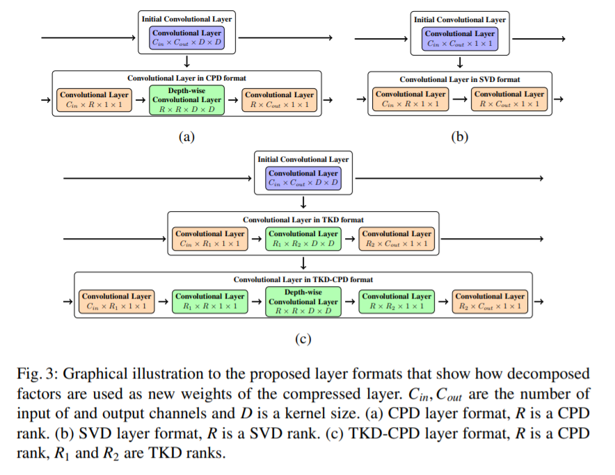
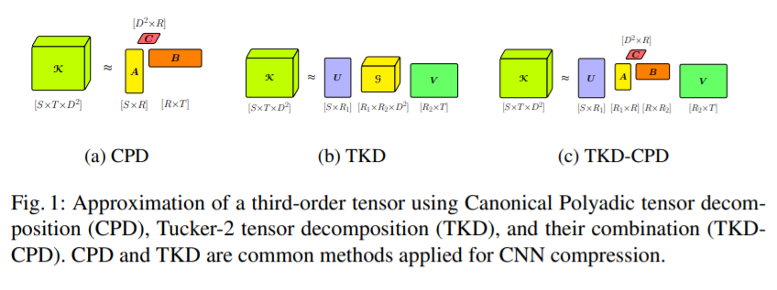
Stable Low-rank Tensor Decomposition for Compression of Convolutional Neural Network Anh-Huy Phan 1 , Konstantin Sobolev 1 , Konstantin Sozykin 1 , Dmitry Ermilov 1 , Julia Gusak 1 , Petr Tichavsk y´ 2 , Valeriy Glukhov 3 , Ivan Oseledets 1 , and Andrzej Cichocki
Tensor decomposition of convolutional
Kernels
CPD (PARAFAC)
Evaluate on popular CNN architectures
for image classification

Slide 9
Issues
https://www.youtube.com/watch?v=EmLHOGT0v4c
Non-overlapping patches
Videos

